Slide 1
Powering Outcomes
at the Point of Care

Slide 2
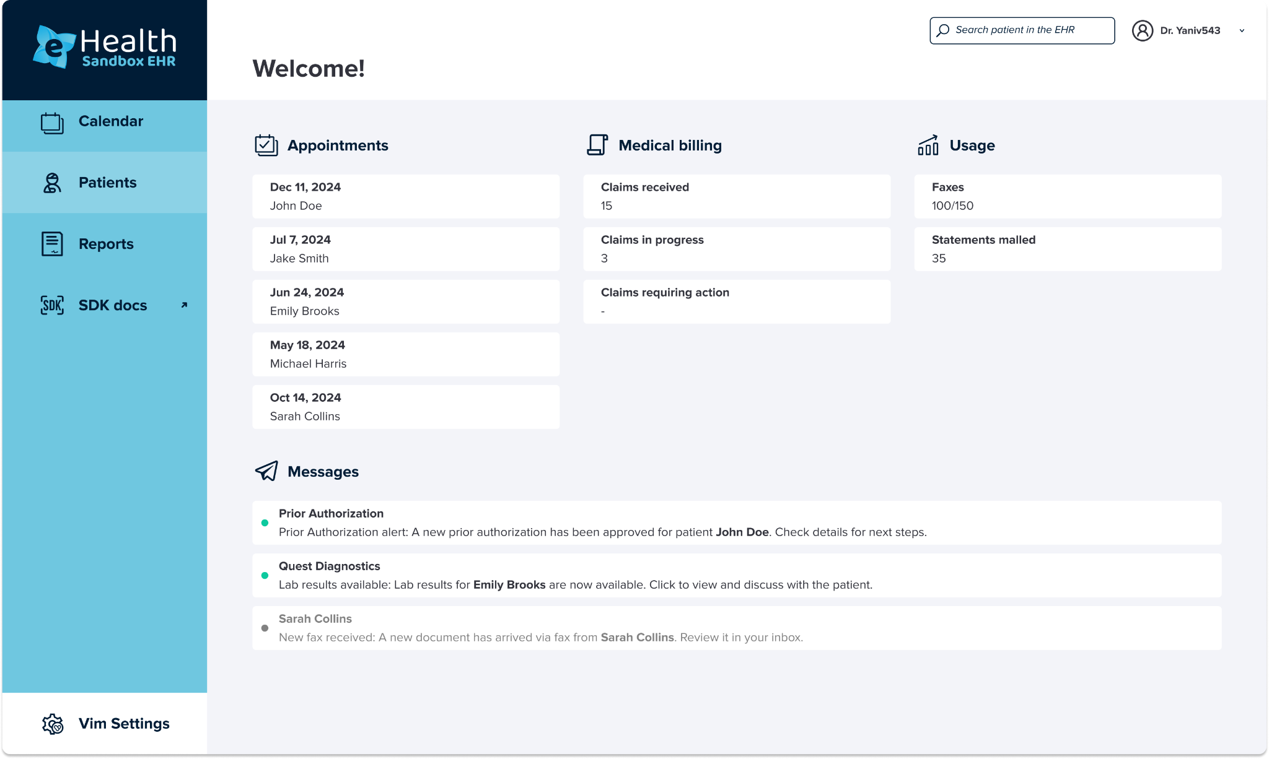
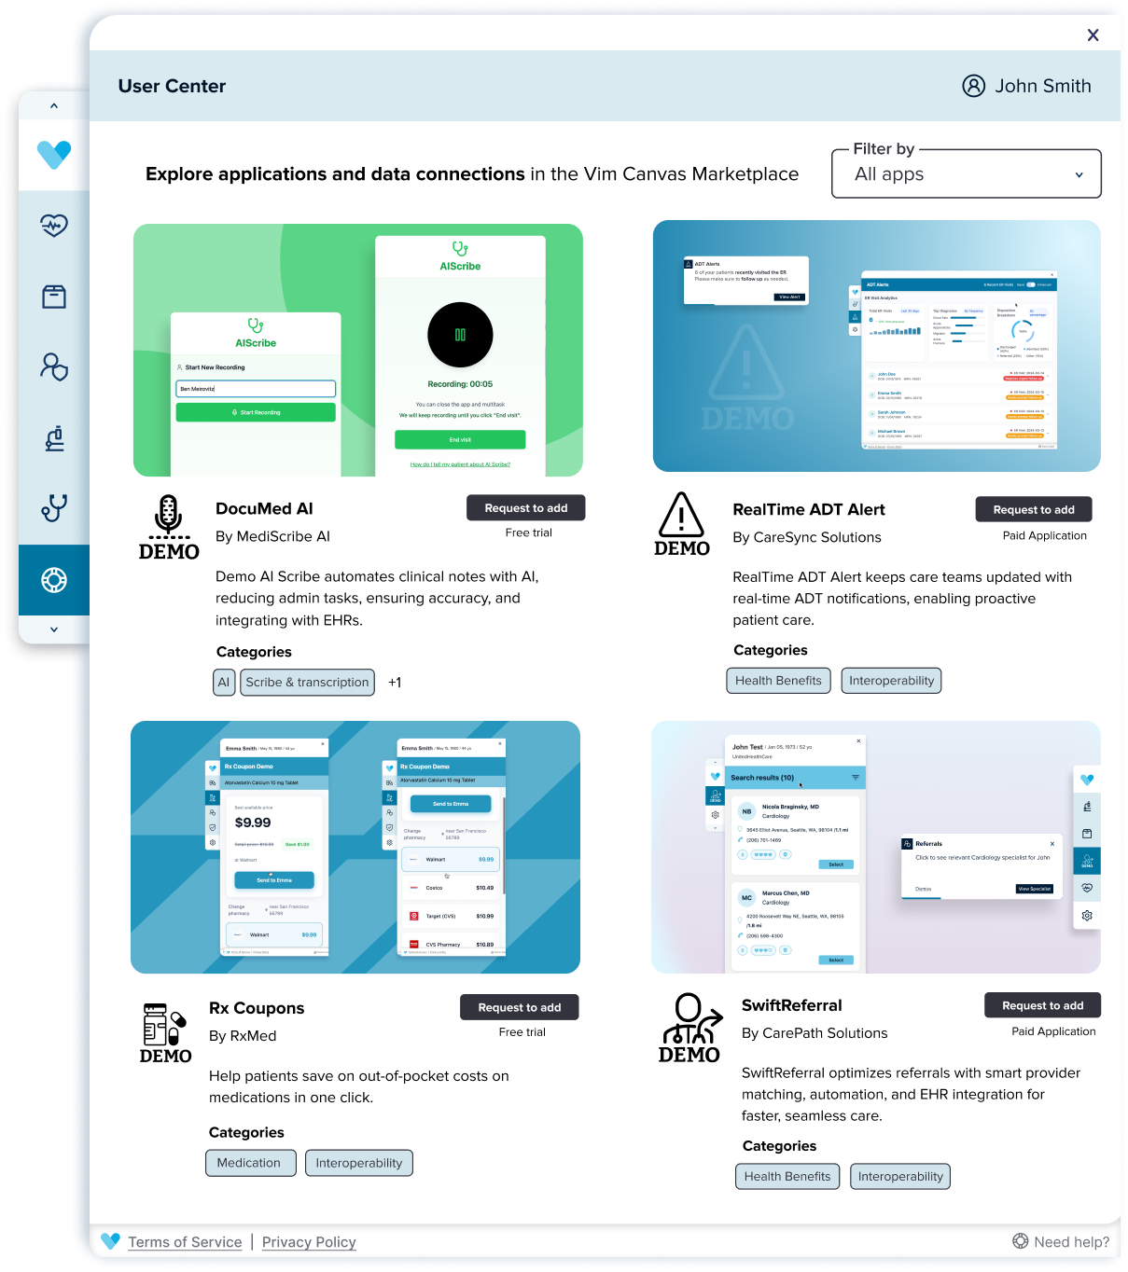

Meet
The point-of-care provider engagement platform built for performance
What we do
Vim connects the tools and data care teams need, right inside the EHR, so they can focus on patients, not portals.
Why it matters
We’re not an EHR, Analytics vendor, or data repository. We’re a smarter layer that works across them. Vim helps providers close gaps, reduce friction, and drive better outcomes.
Notes:
Read “why we exist”
Our only priority: unlock the data that matters so care teams can focus on patients, not clicks.
We’ve built an open, unbiased platform where innovation moves fast, developers build boldly, and the right tools show up at the point of care, without friction.

Slide 3

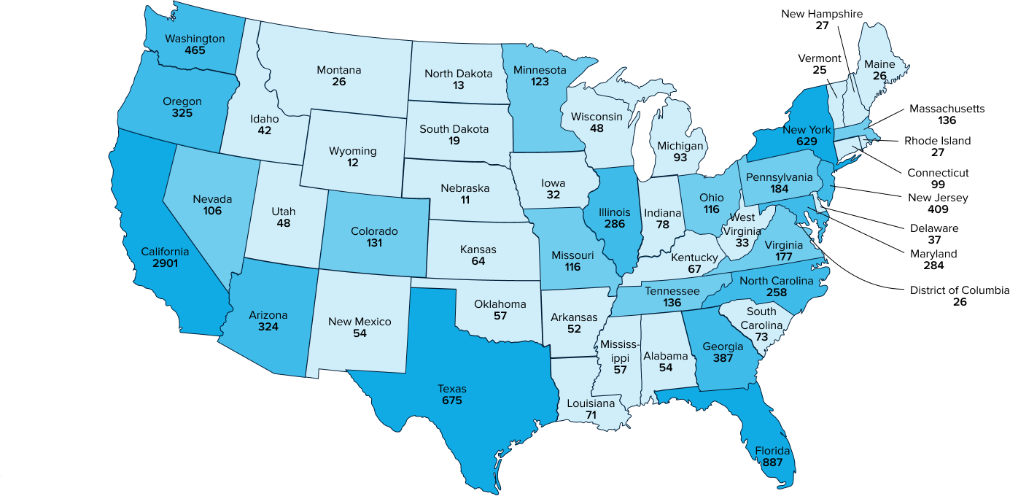
About
15M
Yearly unique patient encounters engaged via the Vim platform
Founded in
2015
Robust network across
50 states
Current
By EOY
13,000+
Provider Orgs/TINs / practices
>50,000
clinical users
30,000
TINs / practices
>100,000+
clinical users
Notes:
Vim was founded in 2015 with one goal: make it easier for providers to focus on patients, not administrative burden.
Today, our technology supports over 15 million unique patient encounters every year.
We’ve built a truly national footprint: our network spans all 50 states, with over 13,000 TINs and more than 50,000 clinical users actively engaging with our platform. And we’re just getting started.
By the end of this year, we’re on track to double that reach: 30,000 practices and over 150,000 clinicians using Vim at the point of care.
This growth is powered by deep partnerships. We work with leading health plans, provider groups, MSOs, and digital health innovators, some of which you see here, from United, Humana, and Centene, to organizations like Aledade, Pearl, and Yuvo.
Each of them shares our vision: to make care delivery more connected, data-driven, and efficient, all right inside the EHR.

Slide 4



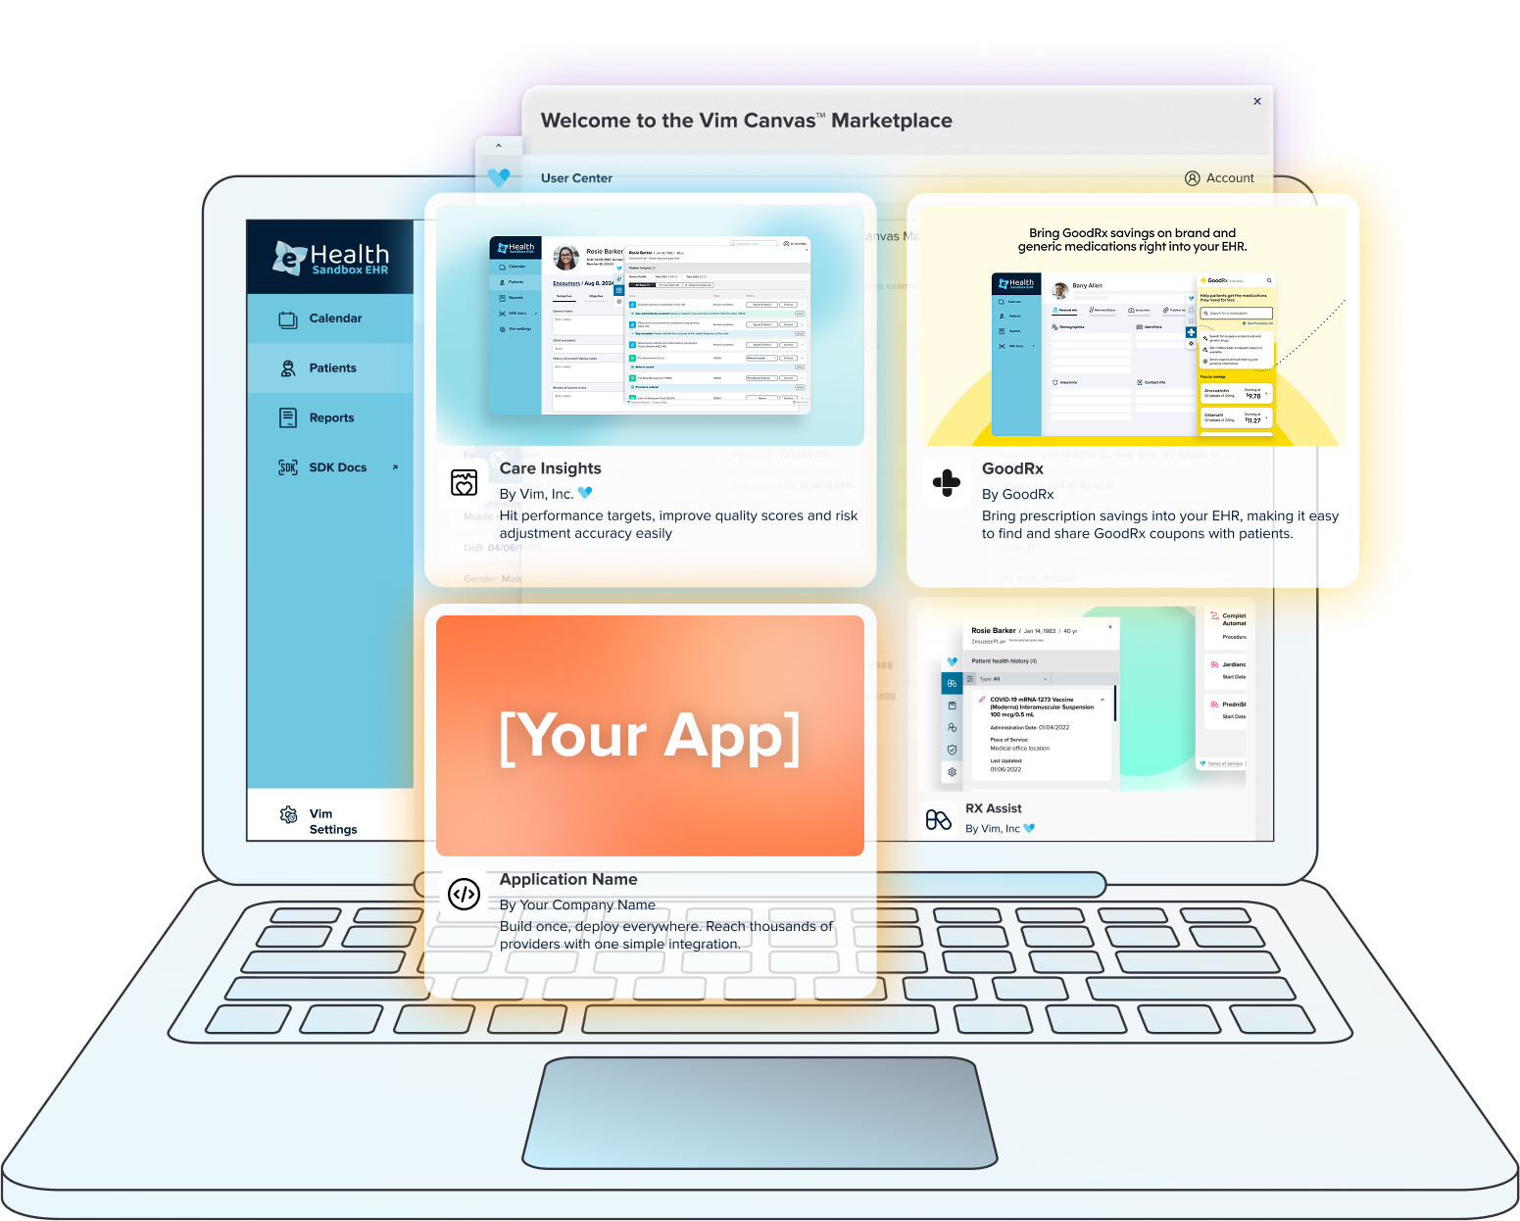



One-Time Login
How Vim Works
Vim apps
3rd party apps
Your apps*
*optional
Vim Connect
API Gateway
Workflow layer
Marketplace & SDK
Security & Compliance
User Experience
Payers
Patient
Data
User Interface
Feedback
Reports
App Interactions
ACOs & MSOs
Other Data Sources
Notes:
Healthcare runs on disconnected systems that slow everyone down: providers, payers, and innovators alike. Data is scattered, workflows don’t talk to each other, and great tools struggle to reach the point of care.
Vim Connect changes that. It sits at the center as the workflow layer that links payers, ACOs, MSOs, and other data sources directly to the EHR. Patient insights flow in; feedback and performance signals flow back out.
On the front end, providers get a unified experience: one-time login, consistent UI, and access to Vim apps, 3rd-party apps, and even their own internal tools, all embedded inside their existing workflow.
For developers, Vim opens the ecosystem. Build once, publish once, and instantly reach scale across many EHRs through the Vim marketplace and SDK.
The result is a connected, orchestrated environment where the right tools show up at the right moment, and care teams can focus on care instead of clicks.
Vim is the quiet engine behind modern healthcare workflows, making everything feel seamless, connected, and fast.

Slide 5
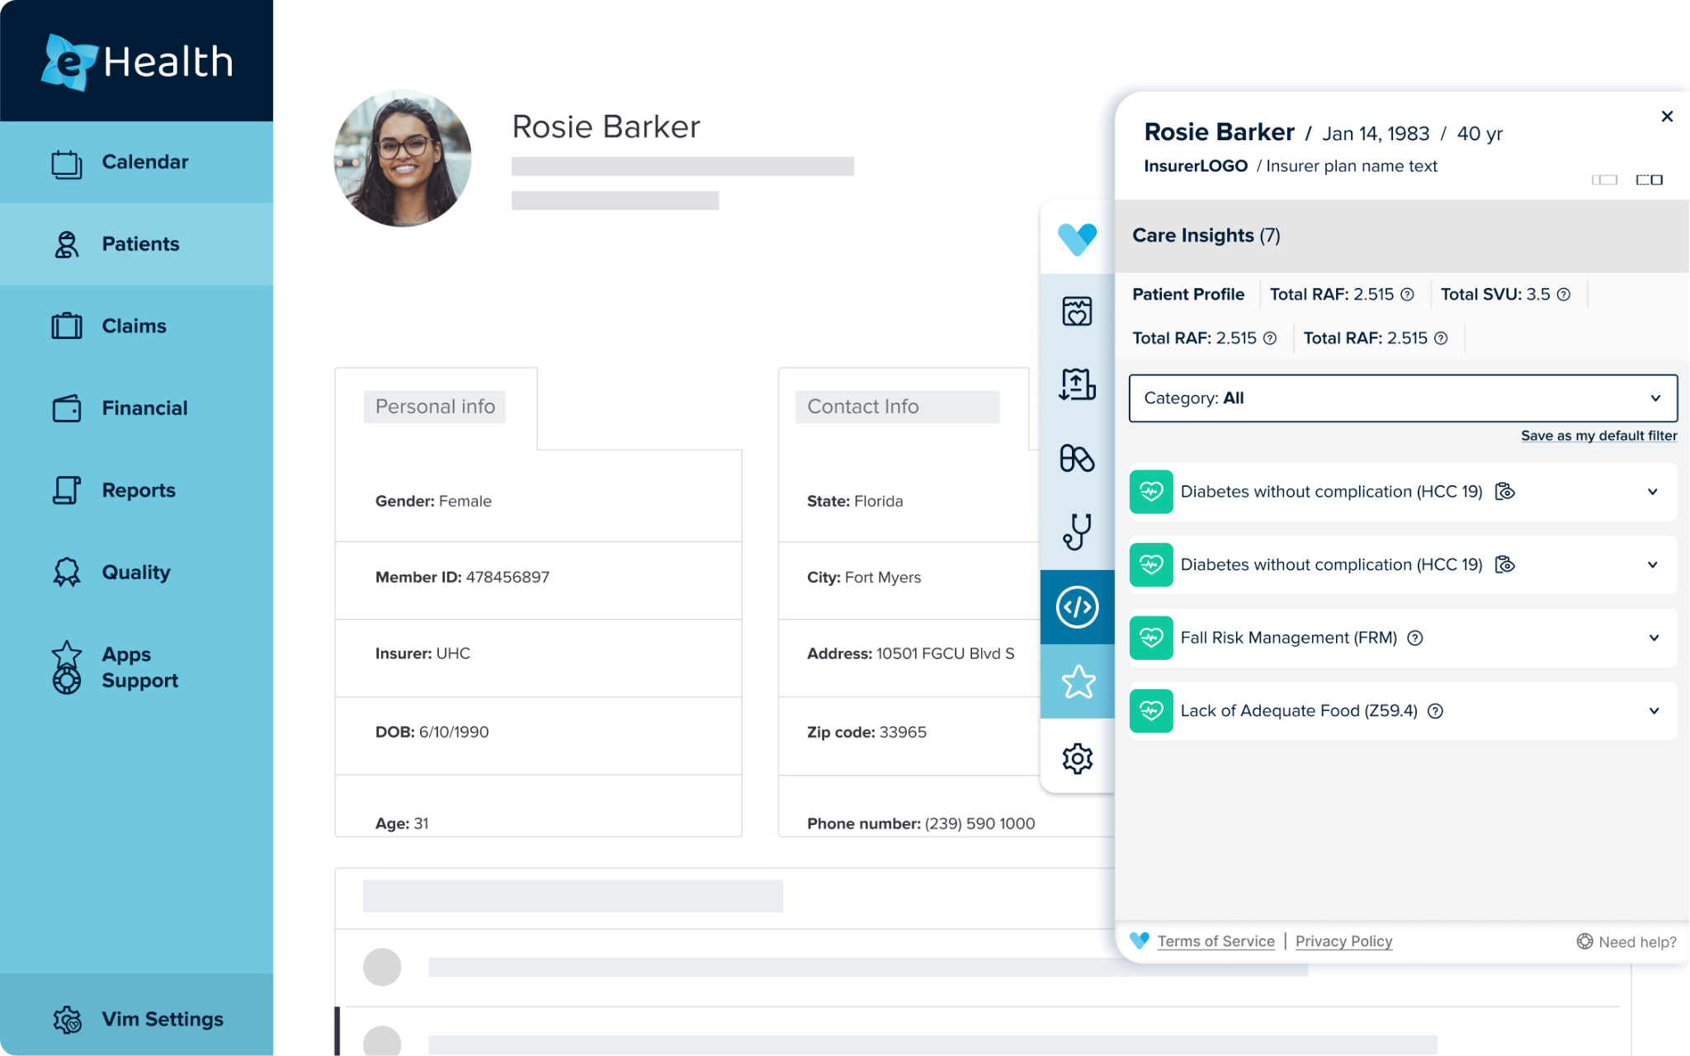
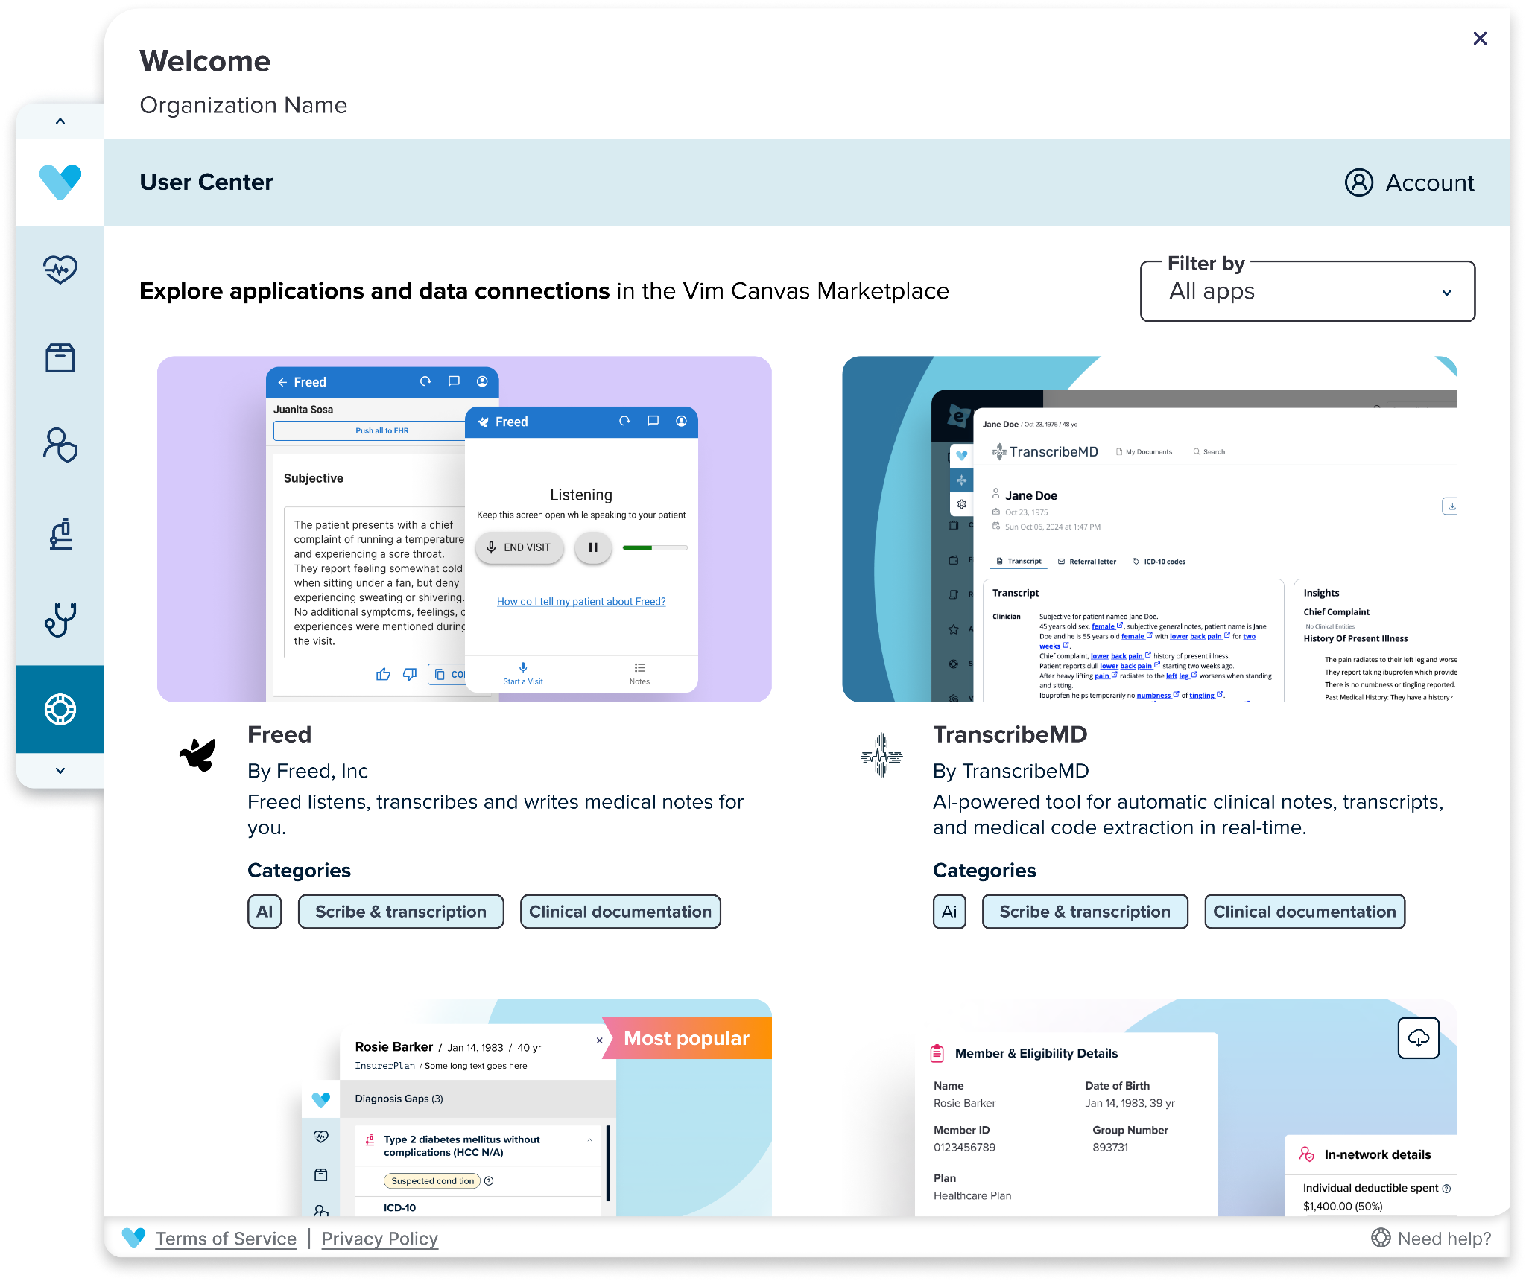
Vim Solution Suite
Value-Based Care
Vim Connect Marketplace
Vim Core Apps
Care Insights
Clinical Data Exchange
Rx Assist
Order Assist
Vim Connect
White Label App
Notes:
Here’s how Vim delivers value at the point of care.
On the left, you’ll see our core suite of embedded apps: these are turnkey tools like Care Insights, Order Assist, and Clinical Data Exchange that come pre-integrated inside the EHR through the Vim Connect application.
These apps are designed to drive real-time provider action—without requiring new logins, reports, or workflows.
{CLICK MOUSE TO TRIGGER ANIMATION]
With a single click on the Vim Canvas icon, users launch the Vim Canvas Marketplace, a powerful extension point that opens the door to even more functionality.
From here, providers can activate curated third-party apps, enable additional use cases, or even deploy custom-built tools, all without any integration headaches.
This flexibility means Vim can support unique strategies across payers, ACOs, MSOs, and providers, while still maintaining a consistent, seamless user experience at the point of care.

Slide 6

Vim Core Applications
Care Insights
Act on external information directly in the EHR
Enabling
Real time actionability via EHR integration
Bi-directional data flow to present insights and capture actions
Reduced clicks and manual processes by streamlining data from one or multiple sources
Better and more seamless patient care plan documentation
Incentive program capture (where/when applicable)
Seamless log-in
Clinical Data Exchange
Automatically retrieves progress notes - no manual chart chasing
Order Assist
Guide referrals to preferred specialists, facilities, and community resources
Rx Assist
Act on curated opportunities to adjust prescribed medications for optimized patient outcomes, improved pharmacy spend, and better adherence

Slide 7
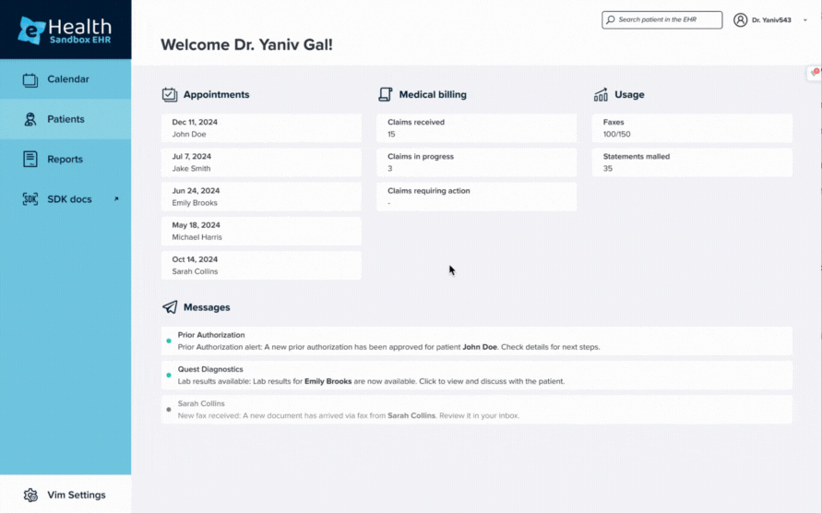
Vim Connect Marketplace
The first-of-its-kind app store for healthcare where 3rd party applications are hosted for easy access by all Vim-enabled care teams - delivering insights and actions directly within their EHR workflow
Notes:
This is the Vim Canvas Marketplace which is our app store for healthcare.
It’s the first of its kind because it truly acts like an app store that you have on your mobile device, giving Vim-enabled care teams easy access to third-party applications embedded directly in their EHR workflow.
That means providers don’t have to leave the EHR to use these tools. Everything happens in one place, which saves time and improves adoption.
You’ll see a wide range of categories, from AI transcription to risk management, affordability tools, mental health, and more. All curated to drive performance at the point of care.

Slide 8




The Difference Vim Enables
Benefits
Outcomes
Improve Provider Satisfaction + Reduce Burnout
EHR Agnostic
Most EHR connections + read/write for fewer clicks
4.25+
STARs across major payer contracts
20%
100
Lift in workflow satisfaction at the point of care
Hours saved per user per year
Payer + Analytics Vendor Agnostic
Most payer data + health tech vendor connections. Build once, deploy everywhere at any time
+0.17
Increase in RAF score due to higher coding accuracy
Improve efficiency through automation
Fast implementation
Implement in minutes vs. weeks
90%+
700+
2K
Provider engagement/ high utilization
More patients can be seen per year with time savings
Hours saved per year for every 1,000 chart reviews
Crowd-sourced feedback
Leverage successful learnings from 1000s of users
Notes:
Let’s talk about the difference Vim makes, not just in tech, but in outcomes that matter to providers and payers.
On the left, you see a few of the platform-level benefits that make Vim uniquely scalable:
We’re EHR agnostic with read/write capabilities and broad coverage across EHRs, which means less clicking, less toggling, and a smoother provider experience.
We’re also payer and analytics vendor agnostic, which means our customers can connect across their ecosystem with a single build — saving enormous engineering time and accelerating deployment.
Implementation takes minutes, not weeks, which is a major unlock in an industry where most integrations drag on for quarters.
And we continuously learn from thousands of users, meaning product improvements are grounded in real-world performance.
In the middle, we’ve highlighted real outcomes from Vim deployments:
Our customers consistently achieve 4.25+ STAR ratings on key contracts.
We’ve helped drive a +0.17 increase in RAF scores, largely due to improved coding accuracy through embedded workflows.
And over 90% provider engagement means our tools aren’t just turned on, they’re used.
On the right, we’ve quantified Vim’s impact based on industry benchmarks and conservative modeling:
Providers using Vim can see up to a 20% lift in workflow satisfaction by removing the need to toggle between portals and disconnected tools which is a known driver of burnout.
That translates to 100 hours saved per provider per year just from reduced administrative burden which is time that can go back into patient care or lower stress.
By reclaiming just 5 minutes per visit, Vim enables providers to see up to 700 more patients per year, without increasing hours. That’s how we help improve both access and revenue potential.
And when it comes to chart review and data acquisition, Vim automates what used to take hours. For every 1,000 charts, we save up to 2,000 hours annually. That’s not just automation, that’s transformation.

Slide 9
Vim Solution Suite

Slide 10
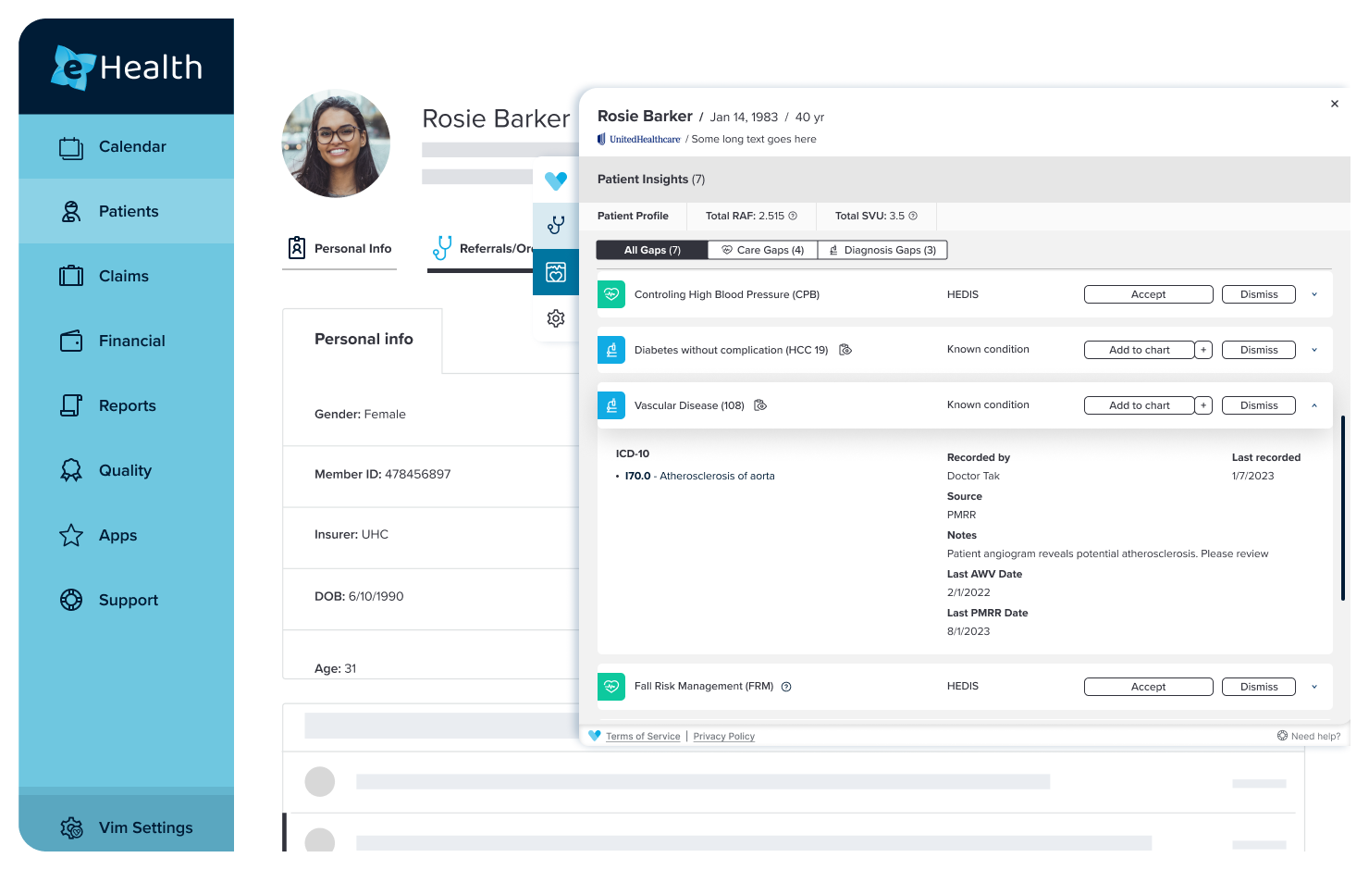



Care Insights - Actionable Patient Information
View Actionable Insights:
Risk adjustment (HCC) opportunities, quality measures (HEDIS, STAR, ACO, etc.), utilization, and more, delivered directly into care team workflows
Enable Fewer Clicks:
Automated writeback of ICD-10 and/or CPT II codes
View + Audit Actions:
Visibility into user actions to understand acceptance rates and dismissal reasons
Connected with most national payers and provider enablers

Slide 11
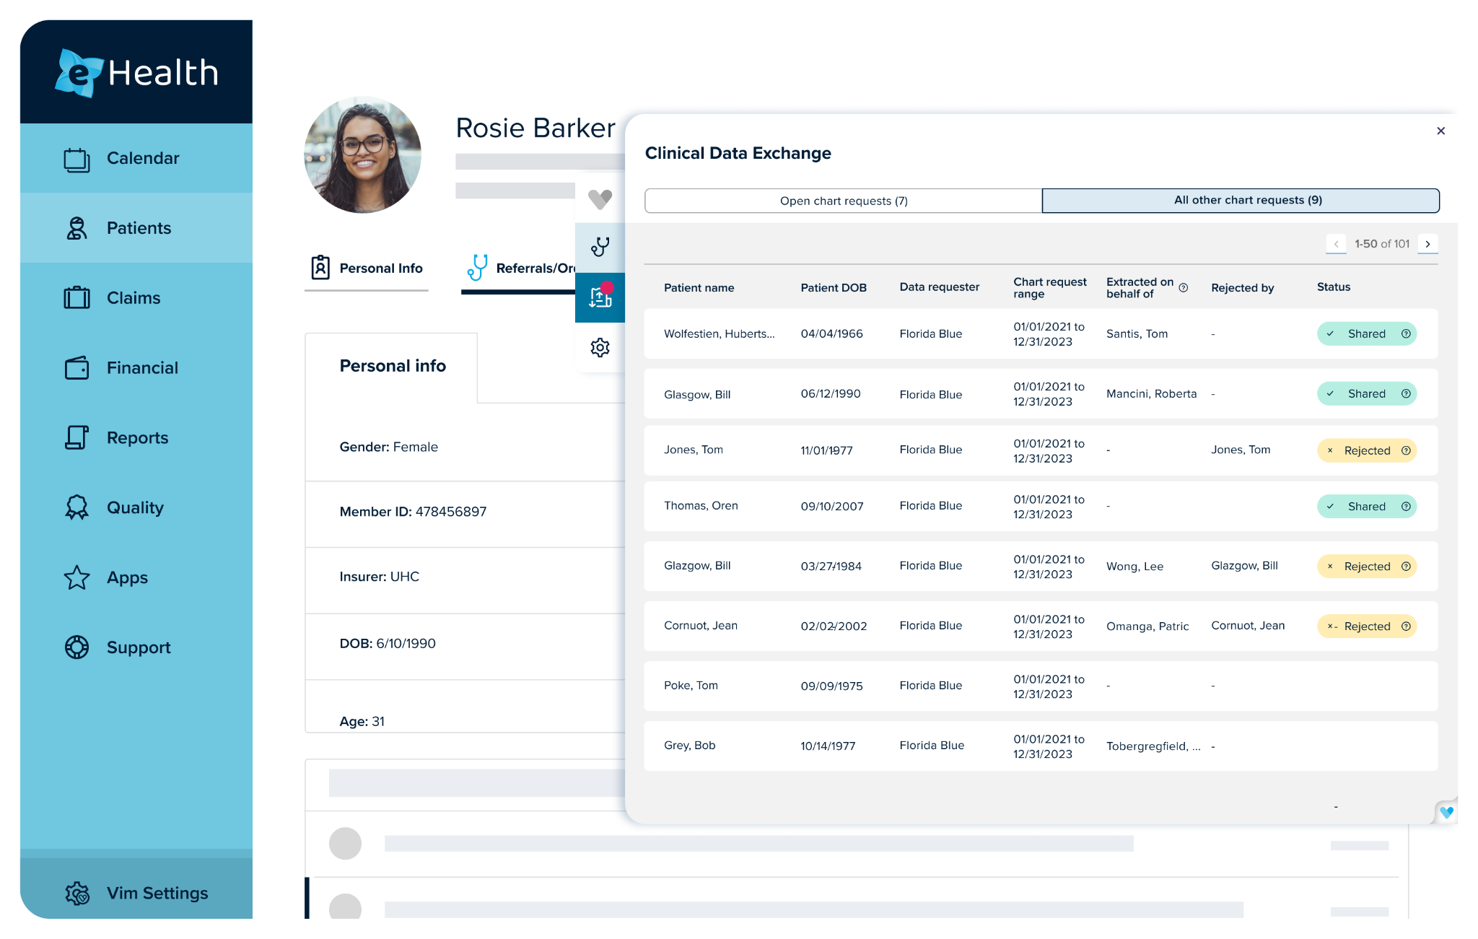



Clinical Data Exchange - Securely + seamlessly exchange clinical data
View Pending Requests: Users can view pending data requests with associated requestor and patient information
View All Historical Requests: Keep track of all requests that have been received over time with the documented status
Automate Extraction Triggers: Certain events in the EHR (like a new encounter) can automatically trigger a chart extraction request to the user

Slide 12
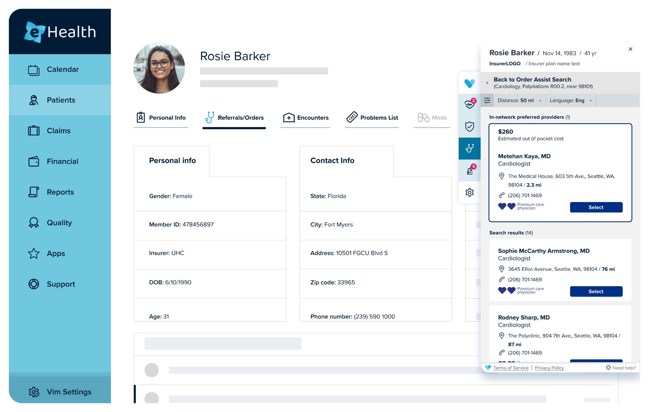
Order Assist - Referral Recommendations
Vim Order Assist enhances referrals flows by presenting high-value specialists and facilities for higher quality and lower costs with greater transparency
Vim Order Assist offers:
High value specialist list delivered in EHR workflow at the time of referral
Simplified process to identify and select high-value specialists
Where Order Assist is most utilized
Where incentives exist to improve referral patterns
Instances where there is an administrative benefit in using an in EHR tool
Aligning with a Value Based partner
Notes:
Potential partner overlap

Slide 13
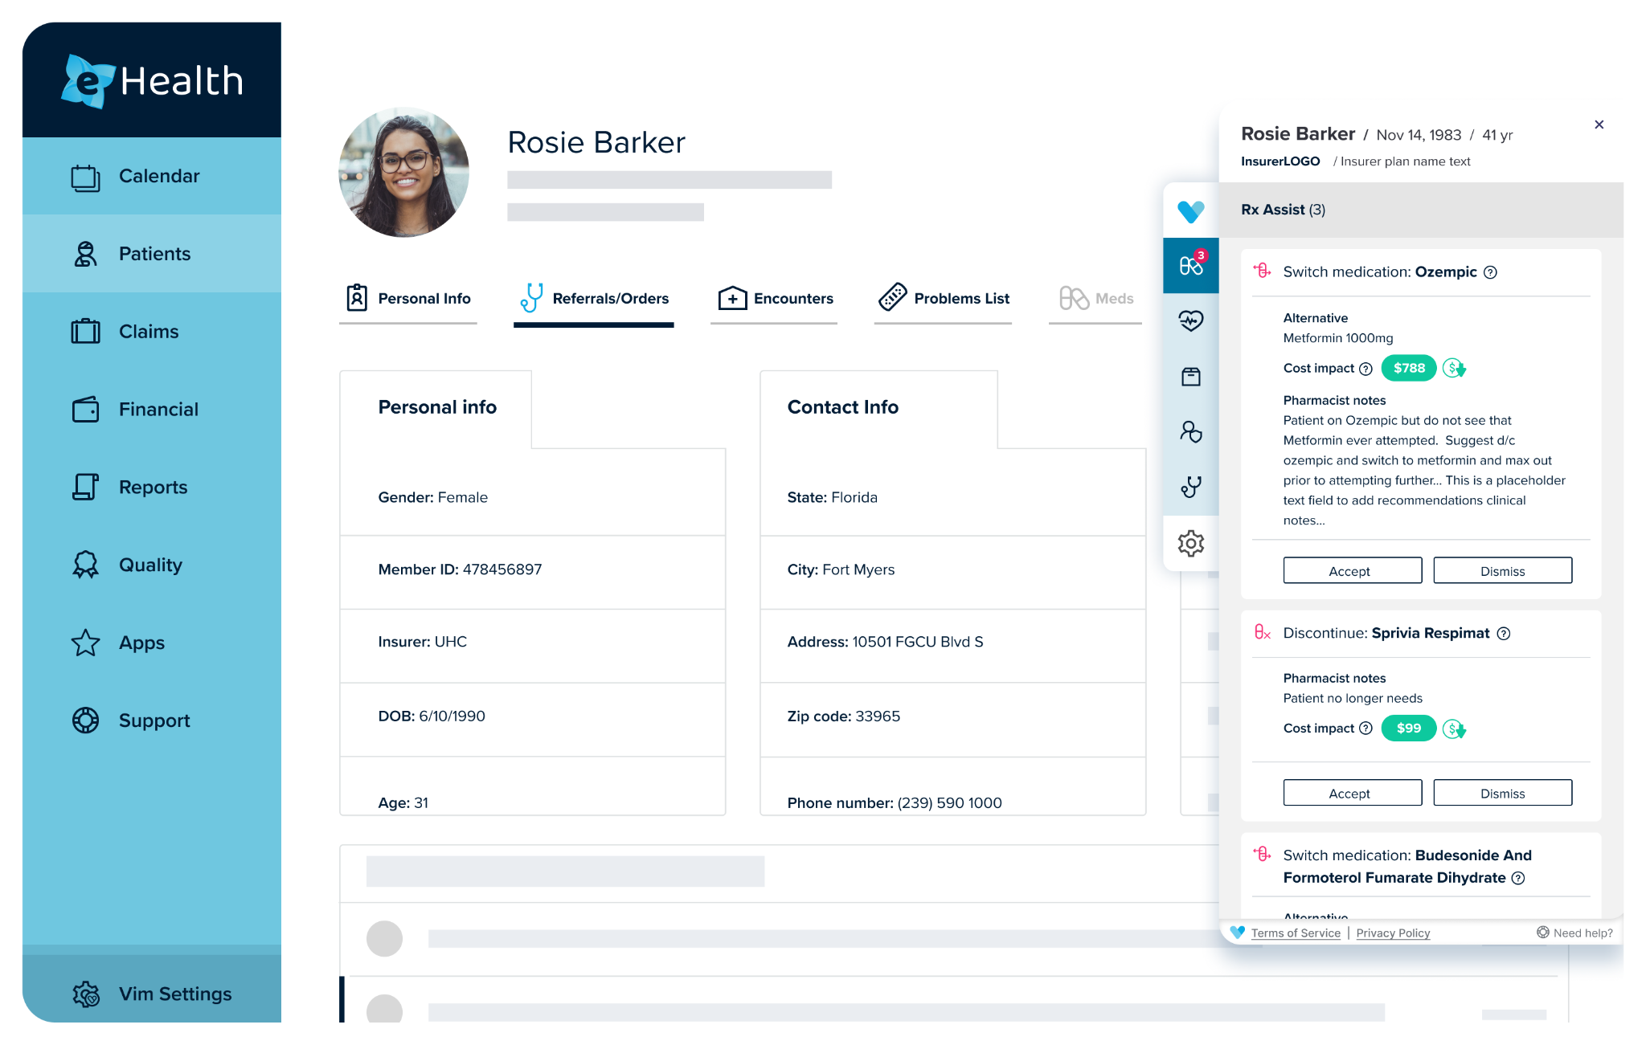
Rx Assist - Medication Assistance
Vim Rx Assist empowers clinicians to make optimal medication recommendations to patients at the point of care, based on available prescription data
Vim Rx Assist offers:
Delivery of Rx adjustment opportunities at the point of care
Visibility into prescribing behavior and cost impact
Ability to save the patient money and better manage dollars at risk
Reduction of provider admin burden caused by managing out-of-workflow Rx recommendations
Potential to empower provider clinical decision-making with patient-specific data

Slide 14
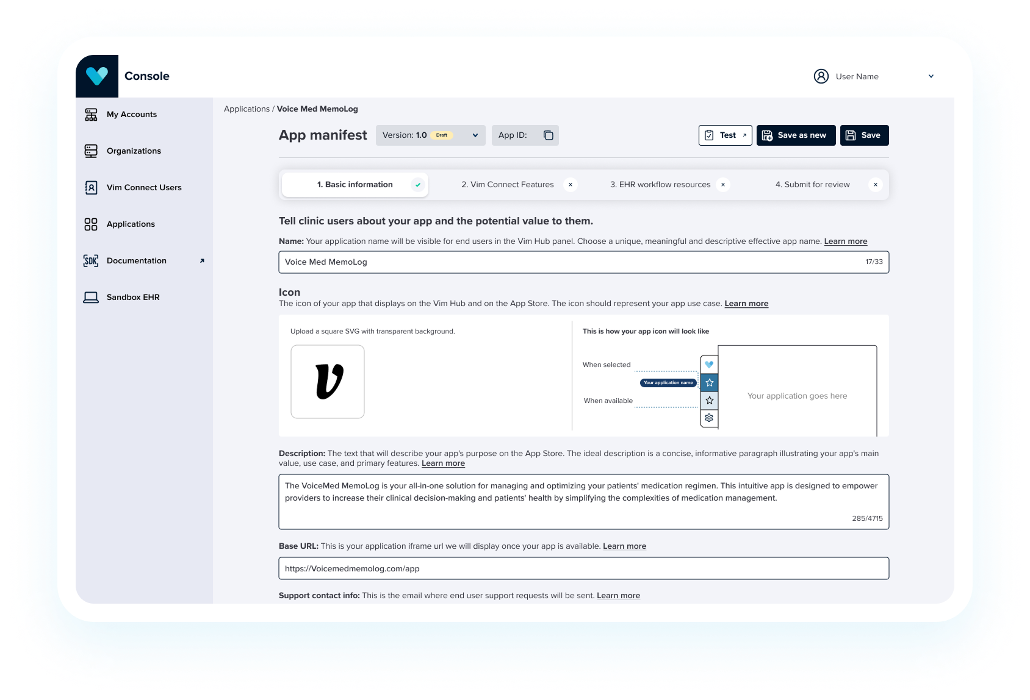
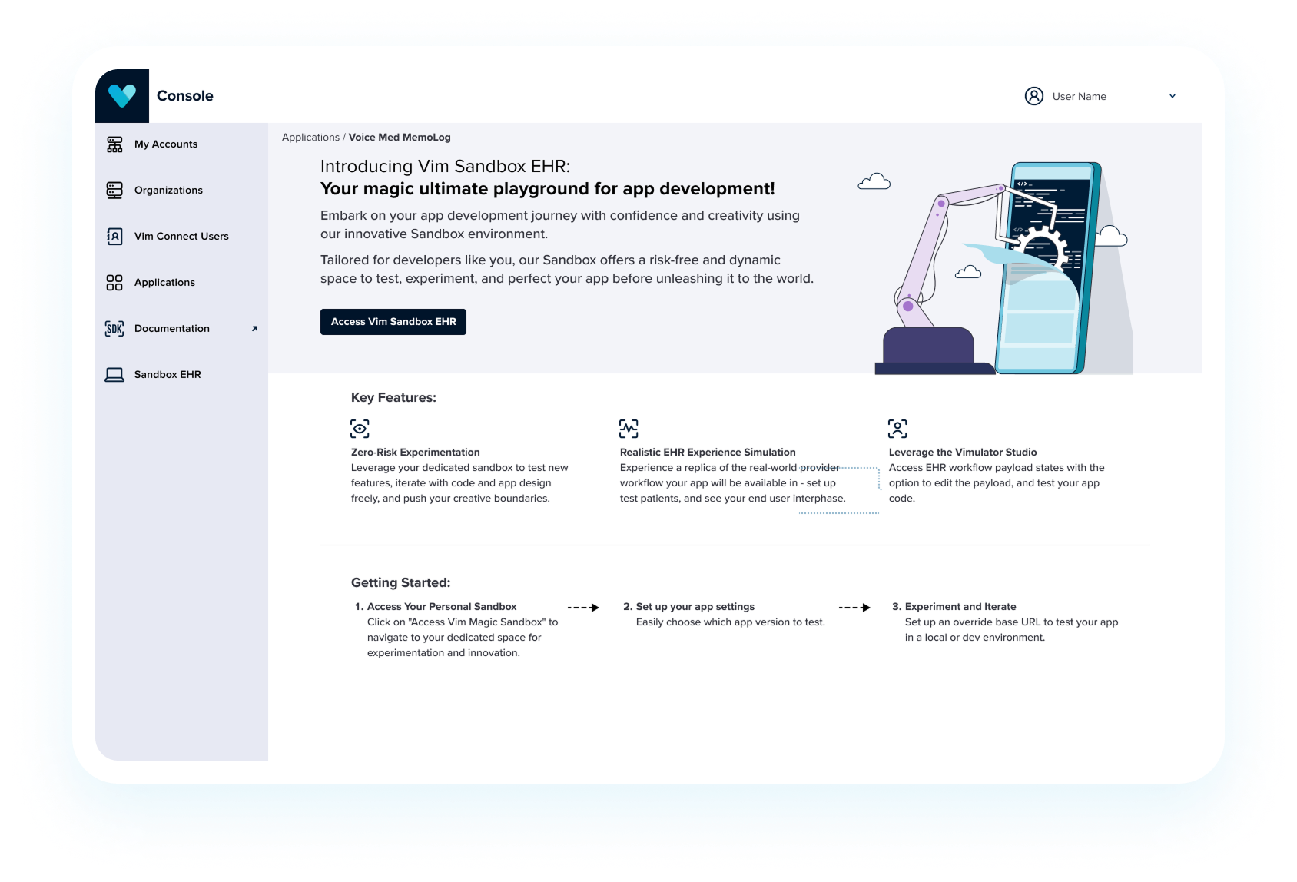
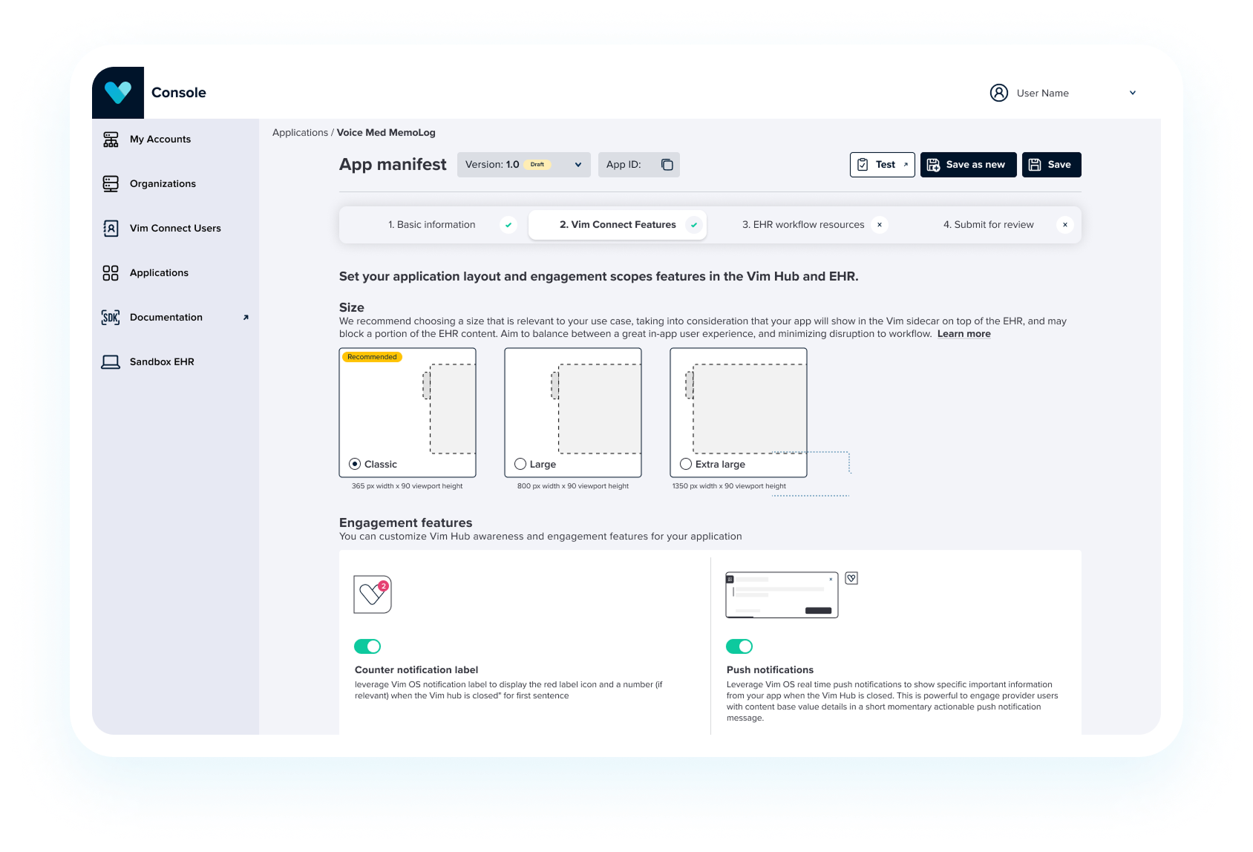
Vim Connect Developer Platform
Seamless, low-code platform for developers to quickly create + test valuable workflow solutions into the point of care; technical teams can leverage LLMs to accelerate developing custom code

Slide 15
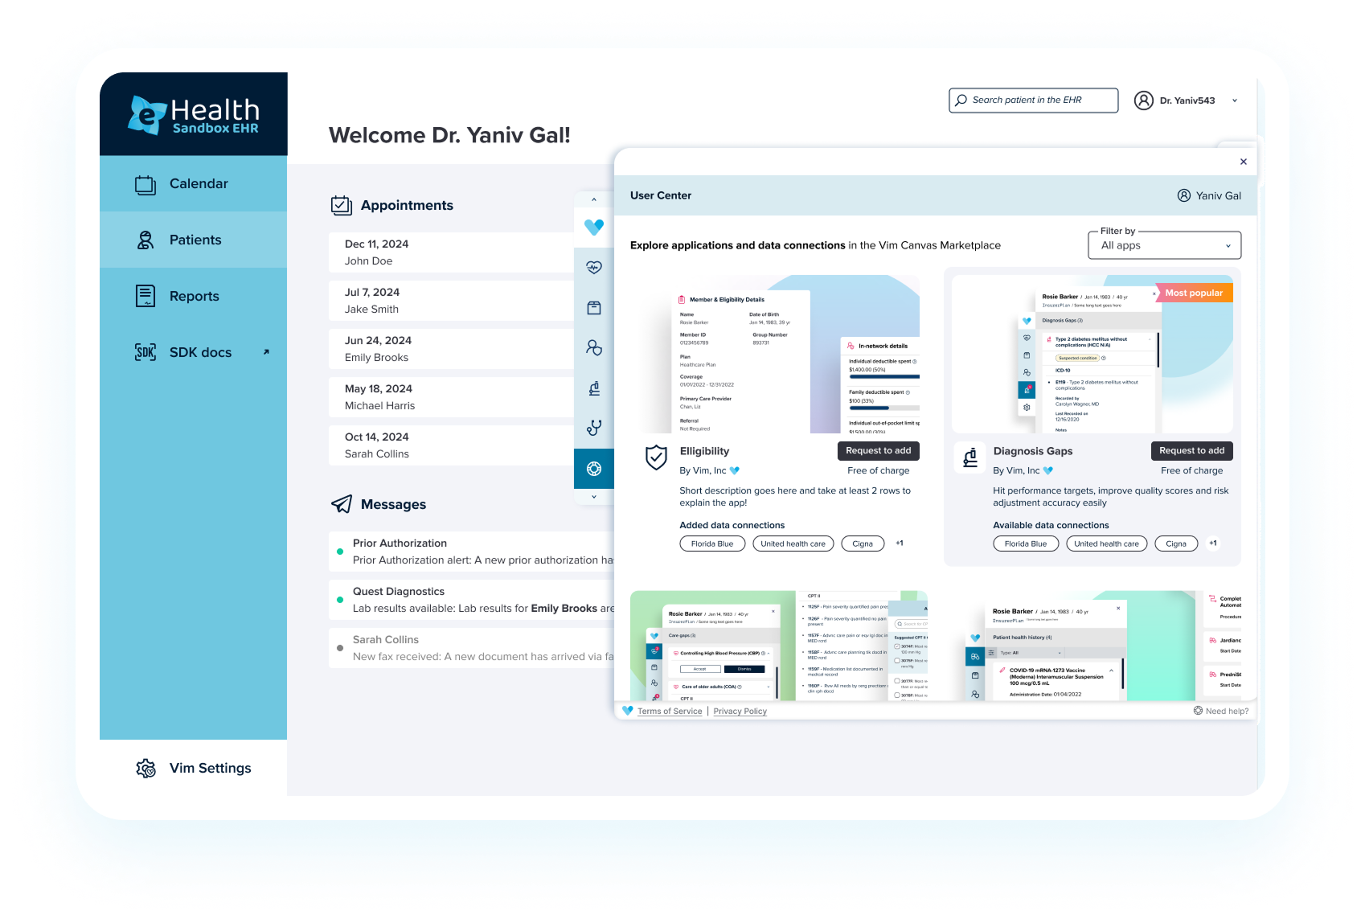
Vim Connect Marketplace
App store where 3rd party developer solutions are hosted for care teams to discover + use
Personalized app marketplace, enabling users to discover, activate, and launch contextually relevant applications - delivering insights and actions directly within their EHR workflow

Slide 16

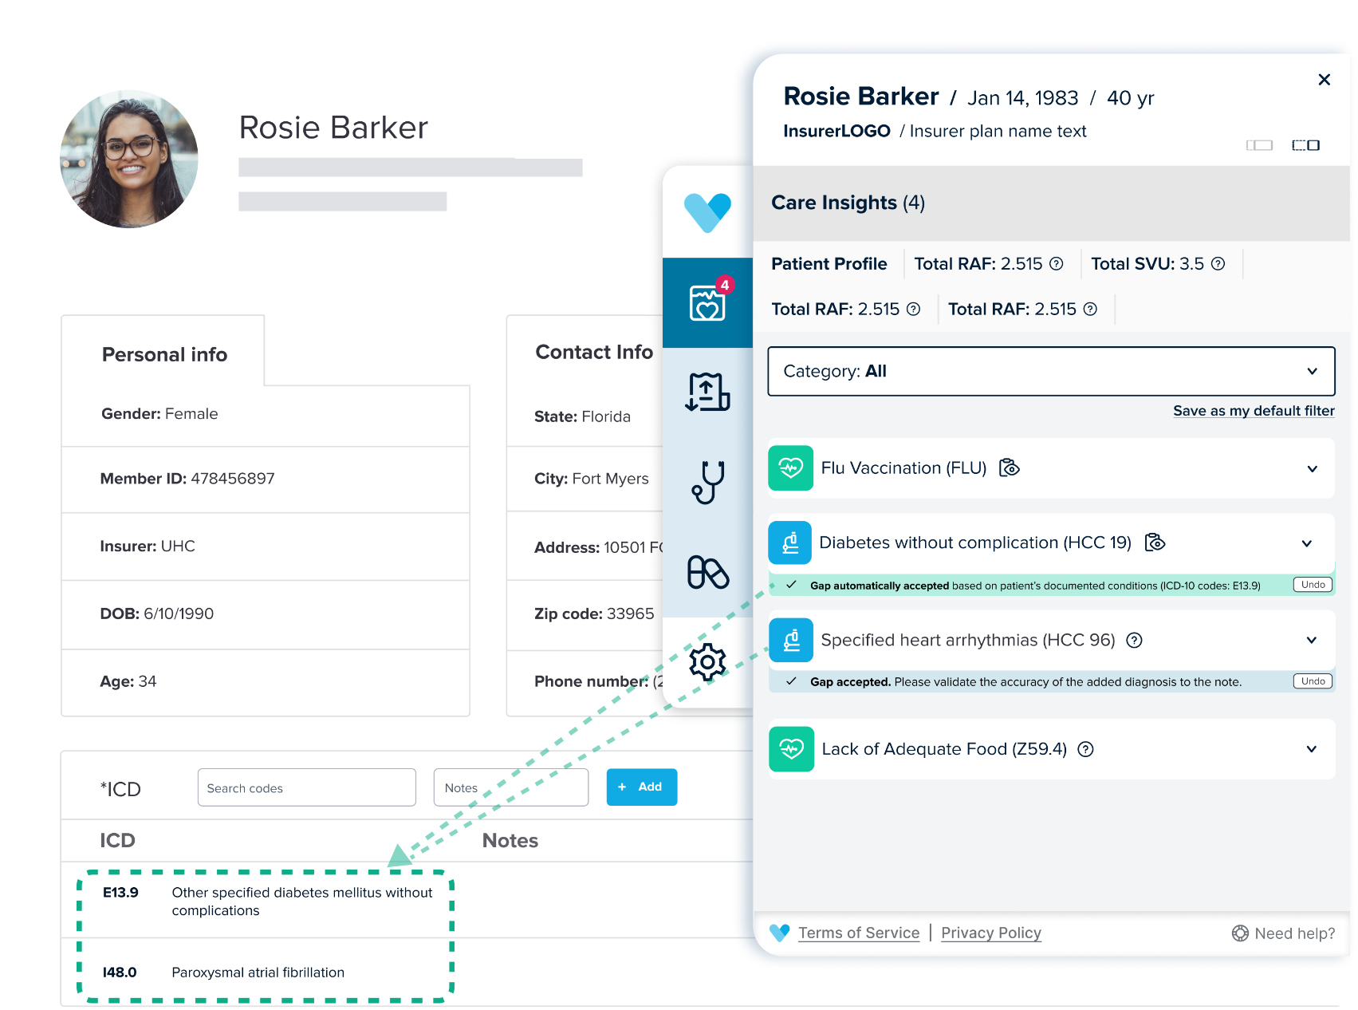
Vim Functionality
Smart Expansion: Vim understands the user workflow, allowing relevant patient insights to show at the relevant time.
1
1
2
Smart Launch: Vim only appears when relevant data is found–no unnecessary pop-ups.
2
Helpful Tooltips: Vim provides 3rd party information when relevant, like NCQA descriptions for quality measures.
3
4
Auto Resolution: Vim automatically resolves gaps when associated ICD-10 codes already exist within the chart.
4
3
5
Automated Write-Back: Vim writes code directly into the EHR, removing manual data entry burden.
5

